Slide 1
Python – RE Library
Karen Bigrigg
http://www.tutorialspoint.com/python/python_reg_expressions.htm
http://www.rexegg.com/regex-quickstart.html

Slide 2
What is the Purpose of the RE (Regular Expressions) Library?
The RE library in Python is used for regular expressions and pattern matching operations in Python. It has patterns and strings to be searched using various functions such as match(), search(), sub() and so on. You use these functions in conjunction with symbols that have specific meaning to process your text.
Regular expressions are widely used in the UNIX world to perform matches or searches on strings or sets of strings.
The specialized syntax is fairly uniform across different programming languages.

Slide 3
Do You have to Install the RE Library?
Nope!
You do need to import this library into your source code:
import re

Slide 4
What is a Regular Expression?
What are they? regular expression is a special sequence of characters that helps you match or find other strings or sets of strings, using a specialized syntax held in a pattern. They are search patterns.
Why are they important? Because if your search is simple, regular expression syntax is simple, it’s portable and fast, it can match about anything and it also can help you write short code.

Slide 5
What is a Regular Expression?
What are some common regular expression patterns?
‘^’ - match the beginning of a line
‘$’ - match the end of the line
‘.’ – match a single character except the newline character
‘*’ - match 0 or more of the preceding pattern
‘+’ – match 1 or more of the preceding pattern
‘?’ – match 0 or 1 of the preceding pattern
^ Matches beginning of line
\w Matches word characters.
\W Matches nonword characters.
\d Matches digits. Equivalent to [0-9]
. Matches any single character except newline. Using m option allows it to match newline as well.
re+ Matches 1 or more occurrence of preceding expression.

Slide 8
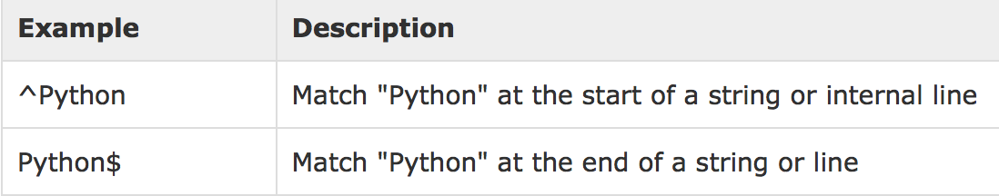
Example
Some common regex patterns are:
Dot (.): Matches any char except newline
Caret (^): Matches the start of a string and Dollar($) matches the end of a string
Star (*): Matches 0 or more repetitions and Plus(+) matches 1 or more repetitions of the regex
Example: iphone5s
iphone6plus
In Regular Expression: ^i\w.+\d\w

Slide 9
Match()?
This method matches characters at the beginning of an input string and returns the match in a match object. If the string doesn’t match ‘None’ is returned
Example:
>>> word = re.match(‘Ka', ‘Karen')
>>> print(word)
<_sre.SRE_Match object; span=(0, 2), match=‘Ka'>
>>> word = re.match('Sc', ‘Karen')
>>> print(word)
None

Slide 10
Search()?
Purpose and example?
The search() function searches for the first occurrence of the regex pattern within a string.
It returns a match object if the match was a success and nothing if it was a failure.
The search functions checks the whole string and returns the first occurrence of the regex if it is found.
import re
line = ‘Python final lab’
searchObject = re.search(‘final’,line)
if (searchObject):
print ‘Search result: ‘, searchObject
else:
print ‘Not found!’

Slide 11
Search()?
Purpose and example?
Scan through string looking for a location where this regular expression produces a match, and return a corresponding MatchObject instance.
Return None if no position in the string matches the pattern; note that this is different from finding a zero-length match at some point in the string.
>>> pattern = re.compile("d")
>>> pattern.search("dog") # Match at index 0
<_sre.SRE_Match object at ...>
>>> pattern.search("dog", 1) # No match; search doesn't include the "d"

Slide 12
Match() vs Search()?
What is the difference between the two?
re.match() checks for a match only at the beginning of the string,
while re.search() checks for a match anywhere in the string (this is what Perl does by default).
Example:
import re
line = "Cats are smarter than dogs";
matchObj = re.match( r'dogs', line, re.M|re.I)
if matchObj:
print "match --> matchObj.group() : ", matchObj.group()
else:
print "No match!!"
searchObj = re.search( r'dogs', line, re.M|re.I)
if searchObj:
print "search --> searchObj.group() : ", searchObj.group()
else:
print "Nothing found!!“
Result:
No match!!
search --> matchObj.group() : dogs
re.M is a flag to control the meaning of the regular expression. It is short for re.MULTILINE, just as re.I is short for re.IGNORECASE: py> import re py> re.M == re.MULTILINE True py> re.I == re.IGNORECASE True

Slide 13
Sub()?
Purpose and example?
This method replaces all occurrences of the RE pattern in string with repl, substituting all occurrences unless max provided. This method returns modified string.
Format:
re.sub(pattern, repl, string, count=0, flags=0)
Example:
import re
phone = "2004-959-559 # This is Phone Number"
# Delete Python-style comments
num = re.sub(r'#.*$', "", phone)
print ("Phone Num : ", num)
# Remove anything other than digits
num = re.sub(r'\D', "", phone)
print ("Phone Num : ", num)

